Slide 1

Tweek to-do list app
Mariam Tmane

Slide 2

Table of contents
Introduction
Why this app / New Options
Survey/Research findings
User personas/ User stories
Site Map / Mood Board
Low-fidelity Frames
Old Design
High Fidelity Frames
Key Take-Aways

Slide 3
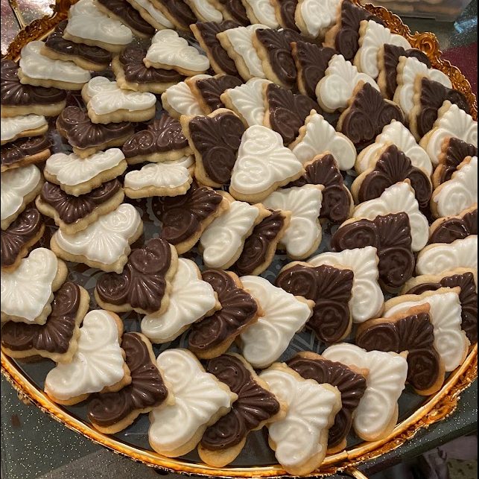
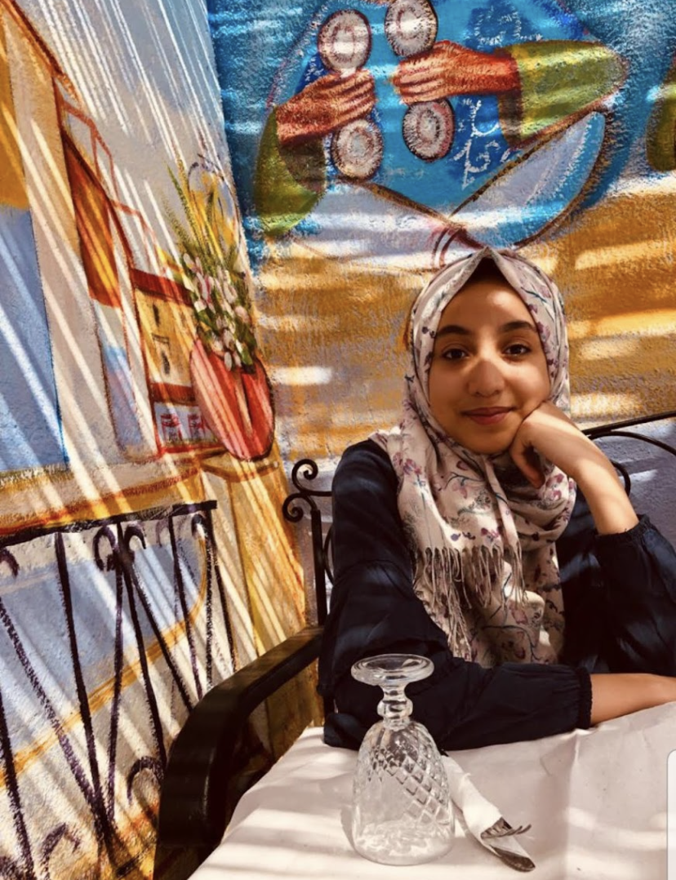
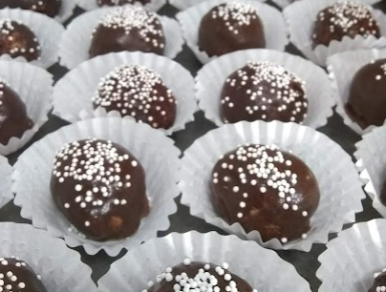
Hi, My name is Mariam Tmane
Hi, I am Mariam, I am a sophomore studying Computer Science. I am interested in front-end development and UX Design. I learned about this Bootcamp from the Girls Who Code discord channel, and at the time, I knew nothing about UX Design, and now here I am presenting to you all my projects. Thank you all for organizing this Bootcamp.
In my free time, I like to cook/bake for my family and friends, I also like to learn Languages, I can speak Arabic, English, and French ☺

Slide 4
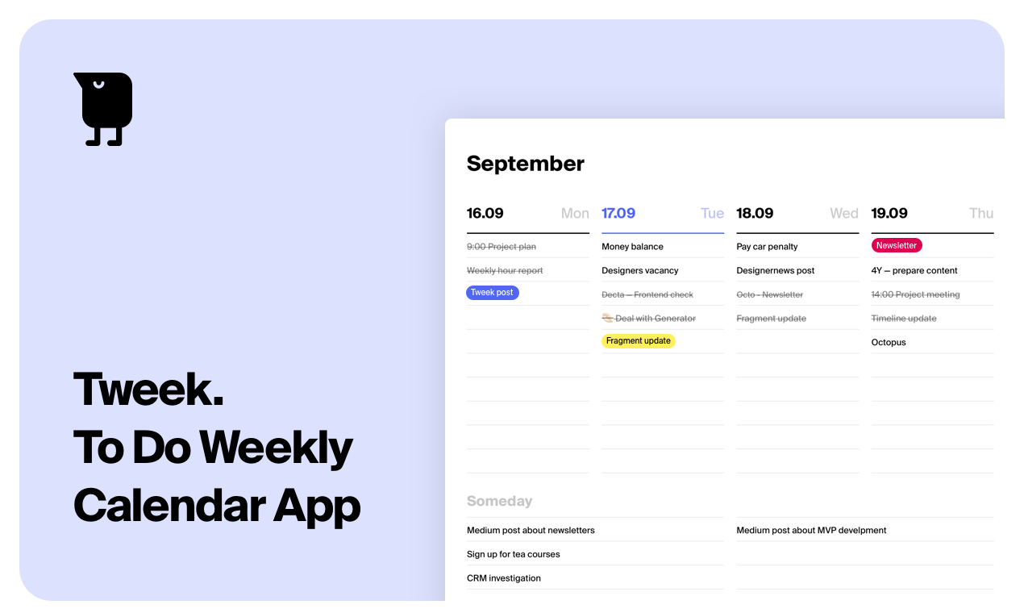
Why I chose this app?
Tweek app

Slide 5

Research/findings
There was a pattern throughout the surveys
The longer the users have been using Tweek
The more they complained about the app being too simple
Use Tweek for School/Classes
→Repetitive tasks.
100%
Feedback from the survey:
“It's plain, the decoration has nothing special in it.”
“I would recommend it to others because it is simple.”
Questions from the survey:
For how long have you been using Tweek?
What do you use Tweek for the most? (Multiple Choice)
Why might you/might you not recommend Tweek to a friend ?

Slide 6
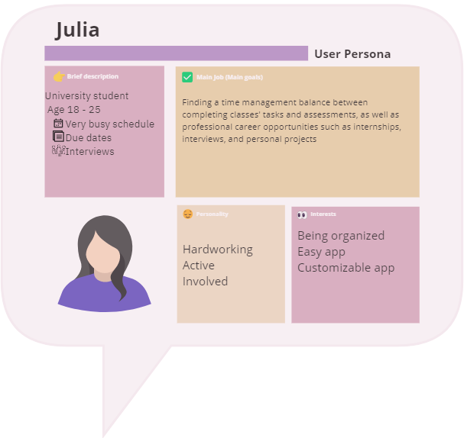
User stories/persona
As Soumaya, I would like a To-do list app that is simple and easy, to stay on top of my school assignments.
As a college student, I would like a To-do list app to be more visually pleasing and customizable so I can continue using it.

Slide 7
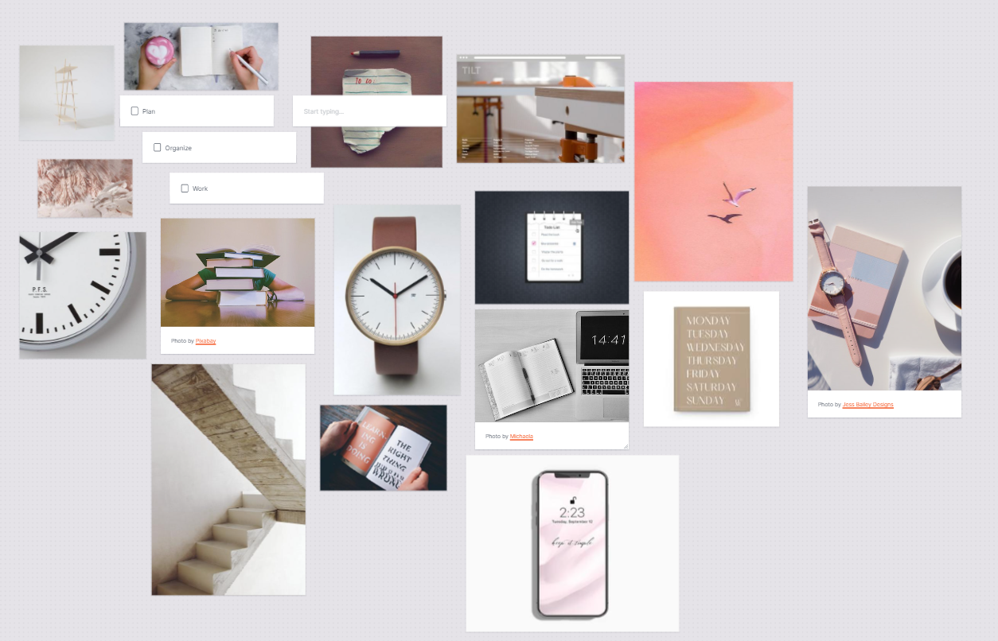
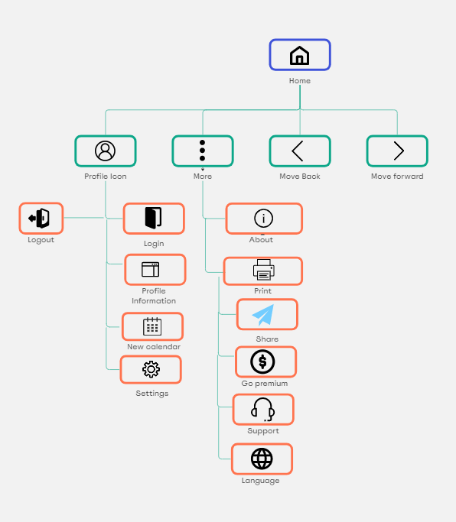
Site map / mood board

Slide 8
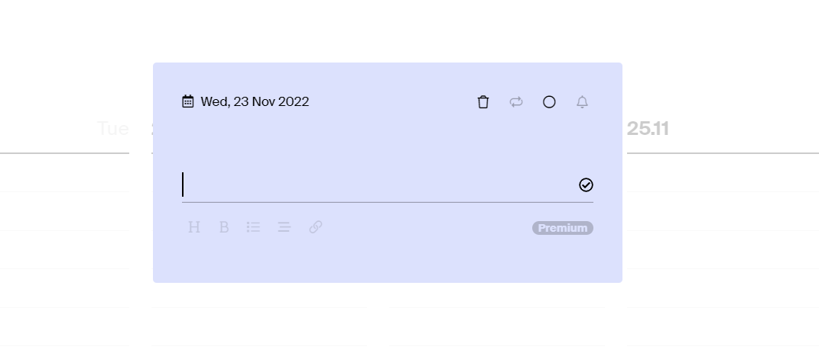
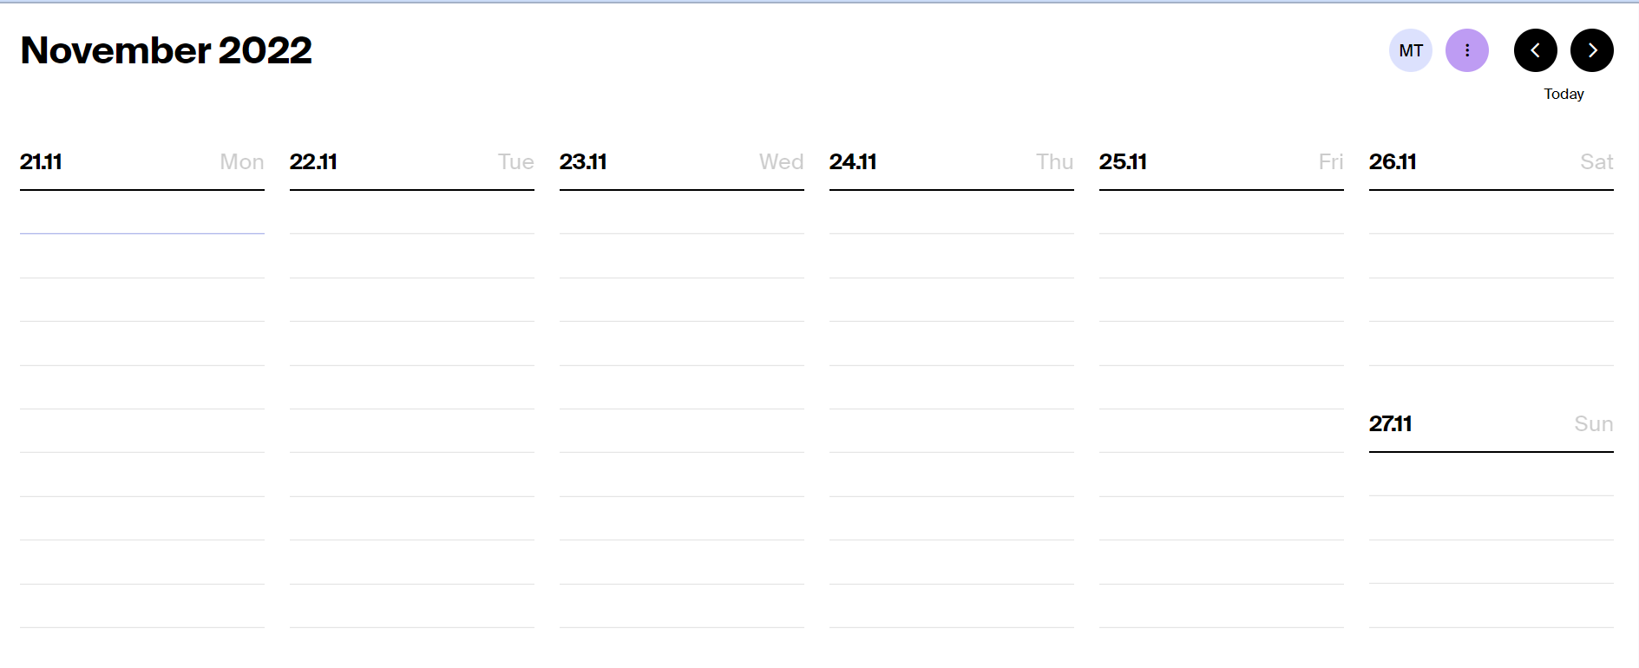
Current Design

Slide 9
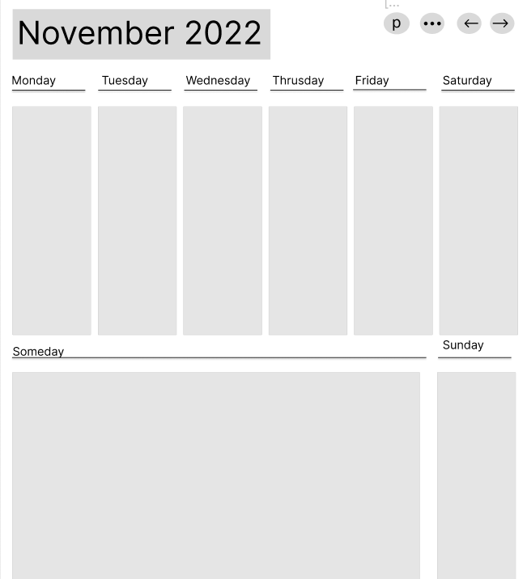
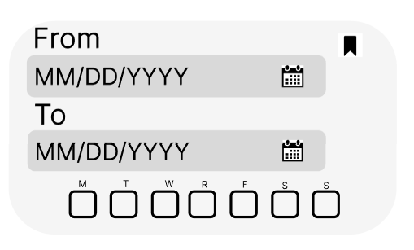

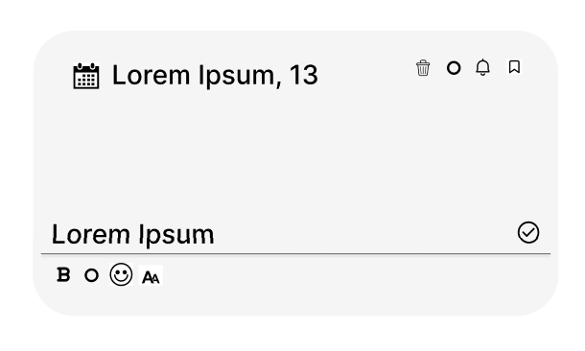
Low-fidelity Frames
Desktop Layout

Slide 10
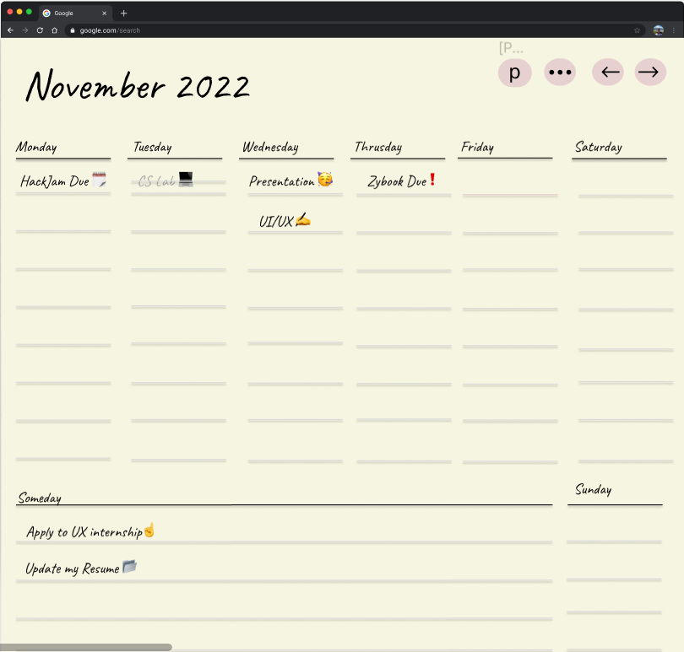

high-fidelity Frames
DESKTOP LAYOUT

Slide 11
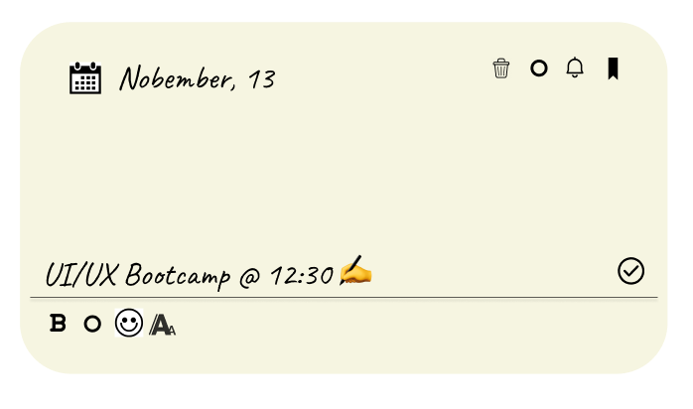
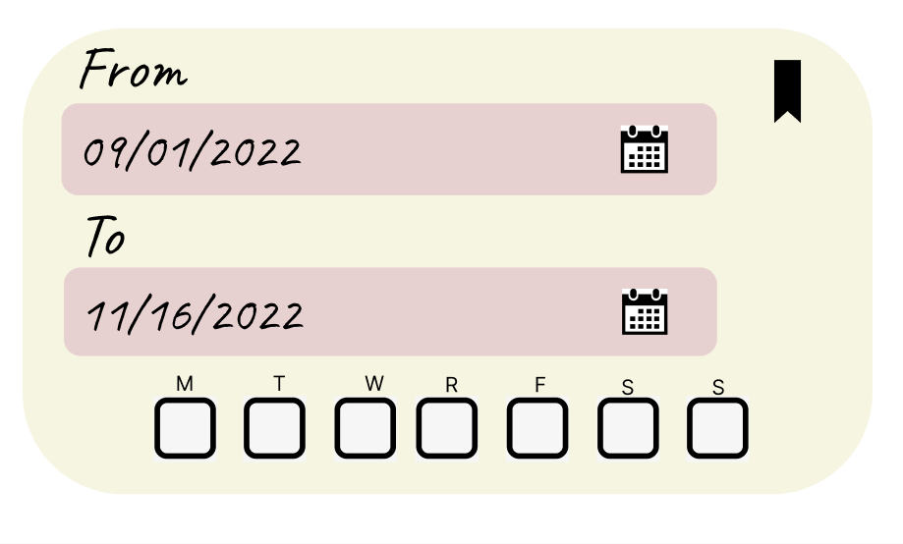
high-fidelity Frames
WHAT’S NEW?
CUSTOMIZATION - EMOJIS, FONT
PICTURE TO THE LEFT, CUSTOMIZING TIME FRAME FOR REPETITIVE TASKS.

Slide 12
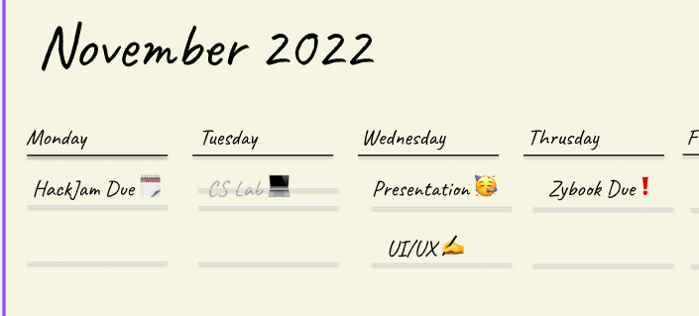
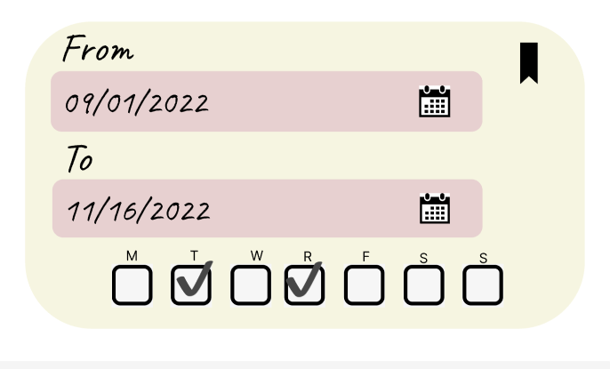

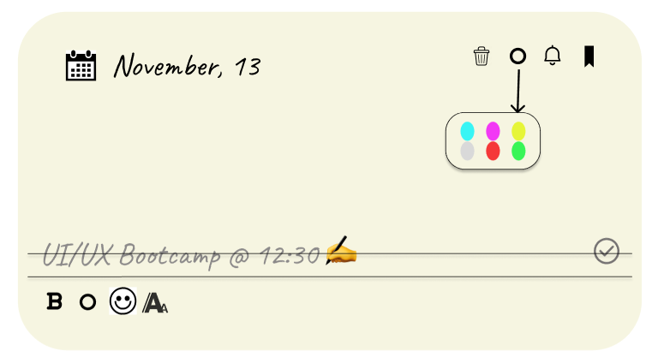
high-fidelity Frames - Options

Slide 13
Project Timeline:
Problem Statement
Week 1:
Learning what UX/UI design is, Writing problem statement.
Survey and research
Week 3:
Created and deployed survey through Typeform.
User persona / site Map
Week 4-5:
Worked on creating user persona, and site map using Miro.
Low-fidelity Frames
Week 6:
Low Fidelity desktop frames using Figma.
High-fidelity frames
Week 7-8:
High-fidelity desktop frames also using Figma & final presentation.

Slide 14


Key Take-aways
Research and feedback are very important and should take different forms, such as interviews and surveys because it brings back new ideas and suggestions.
There is no specific path to getting to the final product.
If I had more time.
Create a storyboard.
Put more time into the design stage

Slide 15
Thank you
Mariam Tmane

